Slide 1
FISH270
Lec9

Slide 2
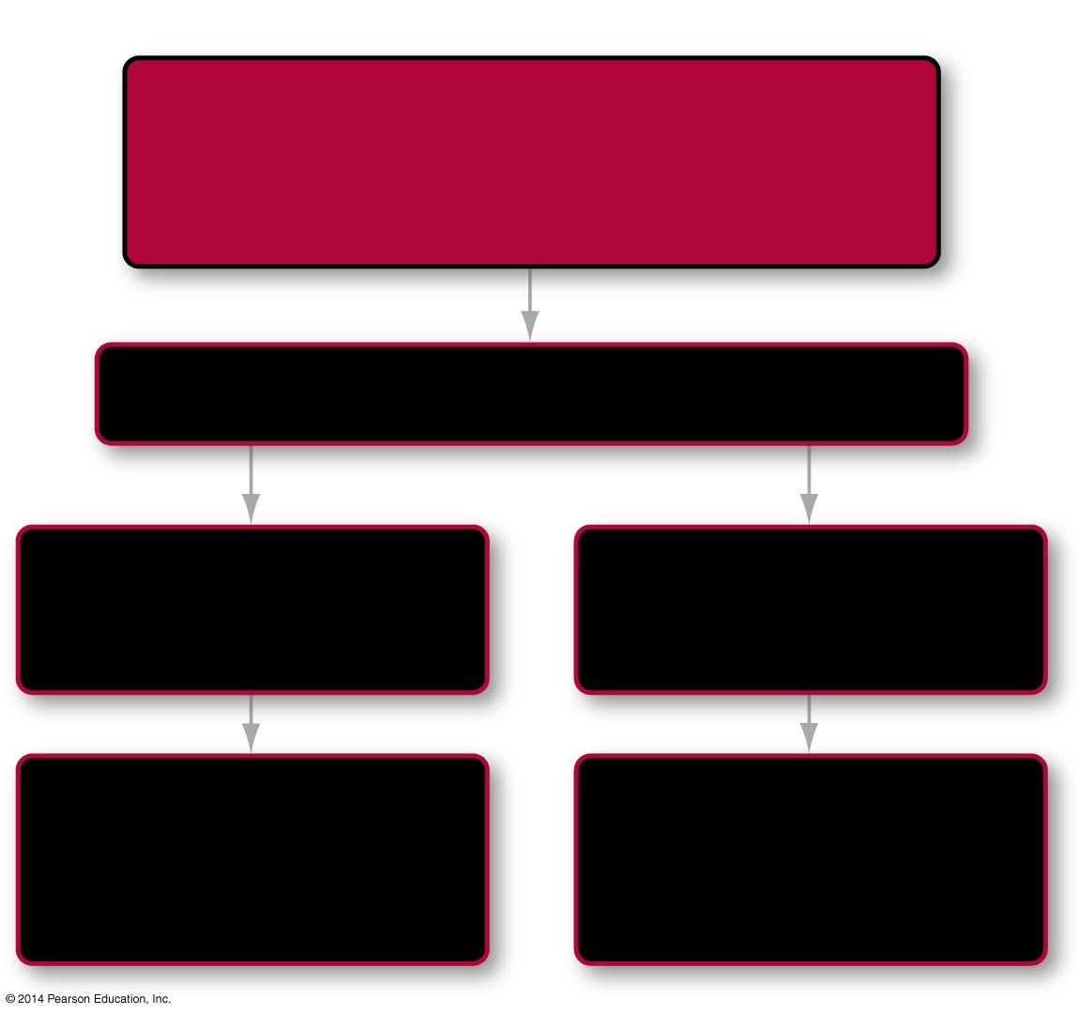
Roadmap 45
In this chapter you will learn that
Animals have adaptations for
gas exchange across body surfaces and
circulation within their bodies
via
Respiratory and circulatory systems
45.1
comparing
exploring
O₂ and CO₂ exchange
in air vs. water
O₂ and CO₂ transport
in blood
45.2
45.4
asking
asking
How do different gas
exchange organs
work?
How do different
circulatory systems
work?
45.3
45.5
Notes:
Chapter 49 Opening Roadmap.

Slide 3
Introduction
Oxygen required for, and carbon dioxide produced by, cellular respiration must be continuously exchanged with the environment
In addition, these gases (along with wastes, nutrients, and other types of molecules) must be transported throughout the body
Cells must obtain oxygen and expel carbon dioxide continuously to support ATP production by mitochondria
Gas exchange involves four steps: ventilation, gas exchange, circulation, and cellular respiration

Slide 4
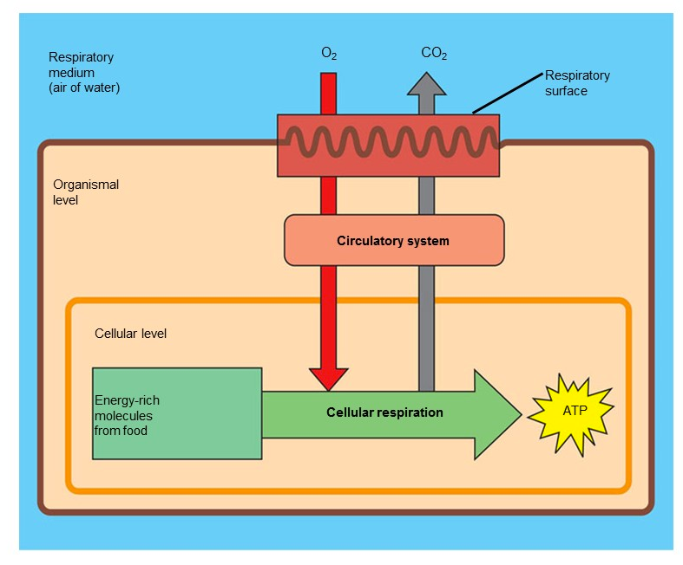

Slide 5
The Four Steps of Gas Exchange
Ventilation occurs when air or water moves through a specialized gas-exchange organ, such as lungs or gills
Gas exchange takes place as CO₂ and O₂ diffuse between air or water and the blood at the ventilatory surface
Through circulation, the dissolved O₂ and CO₂ are transported throughout the body
Gas exchange between blood and cells occurs in tissues, where cellular respiration occurs, and O₂ and CO₂ diffuse between blood and cells

Slide 6
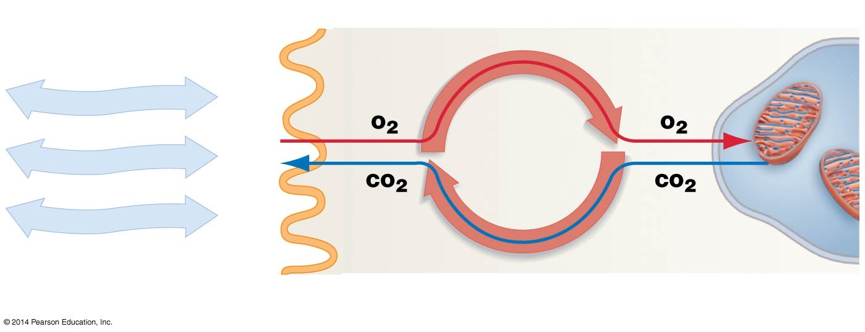

Figure 45.1
1. Ventilation
2. Gas exchange
3. Circulation
4. Cellular respiration
Environment
Respiratory surface
Blood
Mitochondria
Respiratory system
Circulatory system
Notes:
FIGURE 45.1 Gas Exchange Involves Ventilation, Circulation, and Respiration.

Slide 7
The Respiratory and Circulatory Systems
Ventilation and gas exchange are accomplished by the respiratory system
The circulatory system is responsible for moving O₂, CO₂, and other materials around the body
In some animals the gas-exchange surface is the skin, but in most species it is located in a specialized organ like the lungs of tetrapods, the tracheae of insects, or the gills found in mollusks, arthropods, and fish

Slide 8
Air and Water as Respiratory Media
Gas exchange between the environment and cells is based on diffusion
Oxygen is high in the environment and low in tissues
Carbon dioxide is high in tissues and low in the environment
Oxygen thus tends to move from the environment into tissues and carbon dioxide tends to move from tissues to the environment

Slide 9
Behavior of Oxygen and Carbon Dioxide in Air
To understand how gases move by diffusion, it is important to express their presence in terms of partial pressures instead of percentages
Partial pressure is the pressure of a particular gas in a mixture of gases
To calculate the partial pressure of a particular gas, multiply the fractional composition of that gas by the total pressure exerted by the entire mixture (Dalton’s law)

Slide 10
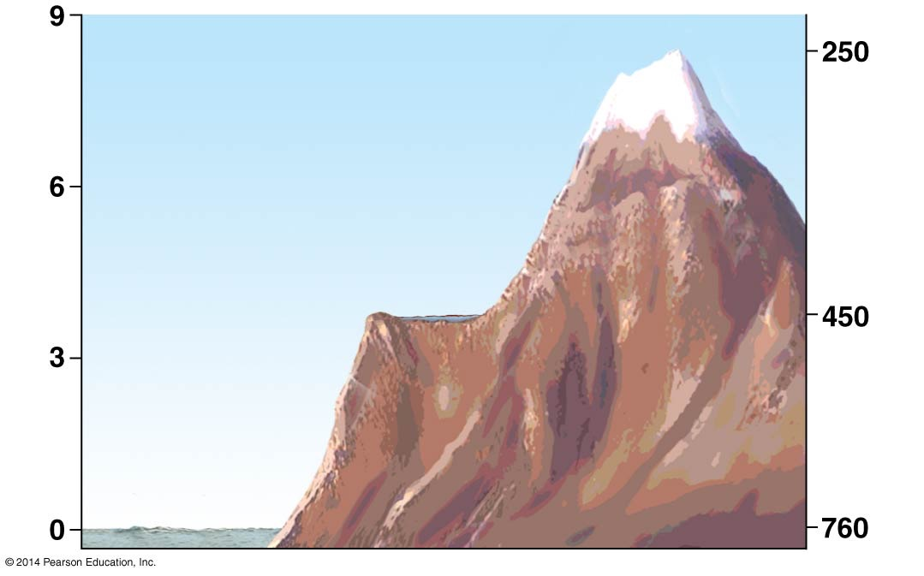
Figure 45.2
Mt. Everest
(PO₂= 53 mm Hg)
Lake Titicaca
Elevation (km)
(PO₂= 95 mm Hg)
Atmospheric pressure (mm Hg)
Proportion of
air that is O₂
Sea level
(PO₂= 160 mm Hg)
0.21 x 760 mm Hg
Notes:
FIGURE 45.2 Oxygen Makes Up 21 Percent of the Atmosphere, but Its Partial Pressure Depends on Altitude.

Slide 11
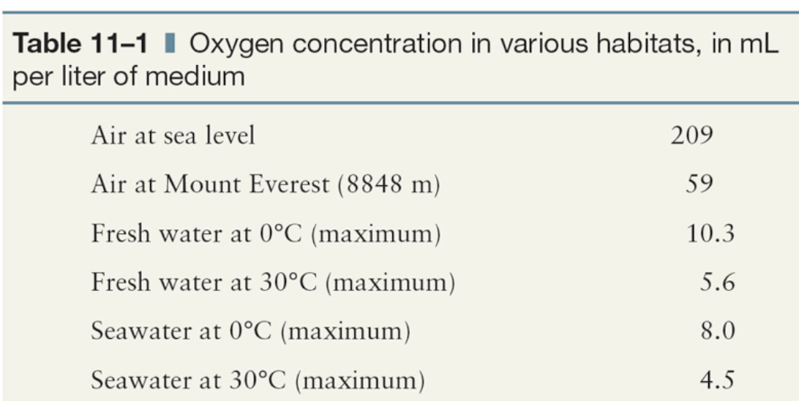

Slide 12
The Diffusion of O₂ and CO₂ in Air
Oxygen and carbon dioxide diffuse between the environment and cells along their respective partial-pressure gradients
In both air and water, oxygen and carbon dioxide move from regions of high partial pressure to regions of low partial pressure
Summary: The diffusion of the two gases is dependent upon the partial pressure gradient
At the top of Mt. Everest the partial pressure of oxygen is low, and thus it is harder to take needed oxygen

Slide 13
Figure 45.2
Mt. Everest
(PO₂= 53 mm Hg)
Lake Titicaca
Elevation (km)
(PO₂= 95 mm Hg)
Atmospheric pressure (mm Hg)
Proportion of
air that is O₂
Sea level
(PO₂= 160 mm Hg)
0.21 x 760 mm Hg
Notes:
FIGURE 45.2 Oxygen Makes Up 21 Percent of the Atmosphere, but Its Partial Pressure Depends on Altitude.

Slide 14
O₂ and CO₂ Behavior in Water
Water has less available oxygen than air
To extract a given amount of oxygen, an aquatic animal has to process 30 times more water than the amount of air a terrestrial animal breathes
Water is about a thousand times denser than air and flows less easily
Water breathers have to expend more energy to ventilate their respiratory surfaces than do air breathers

Slide 15
What Affects the Amount of O₂ and CO₂ in Water
Oxygen and carbon dioxide diffuse into water from the atmosphere, but the amount of gas that dissolves depends on several factors:
The solubility of the gas in water
The temperature of the water
The presence of other solutes
The partial pressure of the gas in contact with the water

Slide 16
The Effects of Photosynthesis and Surface Area
The partial pressure of oxygen varies in different types of aquatic habitats
Habitats with large numbers of photosynthetic organisms tend to be relatively oxygen rich
Habitats where most organisms live off existing organic material tend to be oxygen poor
The most important issue in oxygen availability is often surface area, which has a large impact on oxygen’s ability to diffuse into water

Slide 17
Organs of Gas Exchange: Gills and Lungs
Many small animals exchange gases by direct diffusion across the body surface
They mostly must live in wet environments
Large animals, or those that live in dry environments, need a specialized organ for gas exchange
Respiratory organs provide a greater surface area for gas exchange

Slide 18
Physical Parameters: The Law of Diffusion
Fick’s law states that the rate of diffusion of a gas depends upon five parameters:
Solubility of the gas
Temperature
Surface available for diffusion
Differences in partial pressures of the gas across the gas exchange surface
Thickness of the barrier in diffusion

Slide 19
Physical Parameters: The Law of Diffusion
Fick’s law identifies traits that allow animals to maximize the rate at which oxygen and carbon dioxide diffuse across surfaces
Specifically, Fick’s law states that all gases, including O₂ and CO₂, diffuse in the largest amounts when three conditions are met:
The surface area for gas exchange is large
The respiratory surface is extremely thin
The partial pressure gradient of the gas across the surface is large

Slide 20
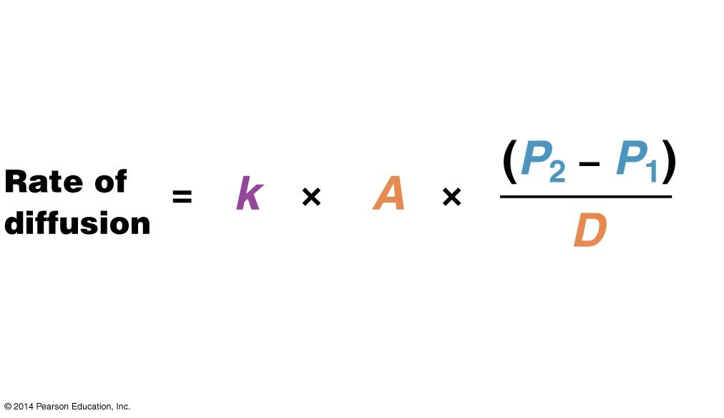
Figure 45.3
Diffusion constant
(depends on
solubility of gas
and temperature)
Difference in partial
pressure of gas on either
side of barrier to diffusion
Area for
gas exchange
Distance
(thickness of
barrier to diffusion)
Notes:
FIGURE 45.3 Fick’s Law Describes the Rate of Diffusion.

Slide 21
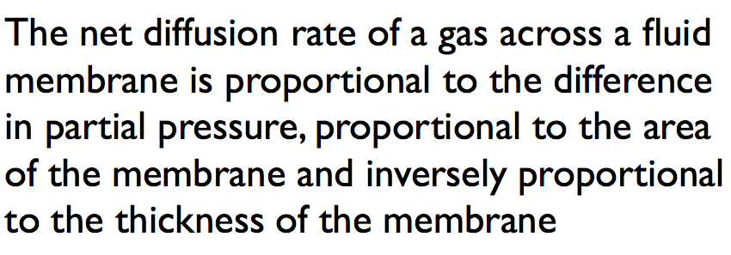
Figure 45.3
Diffusion constant
(depends on
solubility of gas
and temperature)
Difference in partial
pressure of gas on either
side of barrier to diffusion
Area for
gas exchange
Distance
(thickness of
barrier to diffusion)
Notes:
FIGURE 45.3 Fick’s Law Describes the Rate of Diffusion.

Slide 22
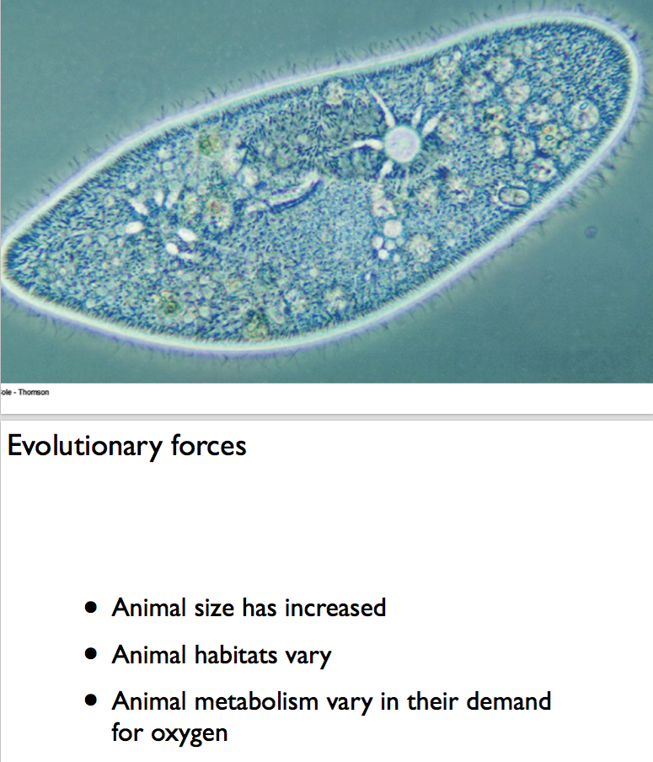

Slide 23
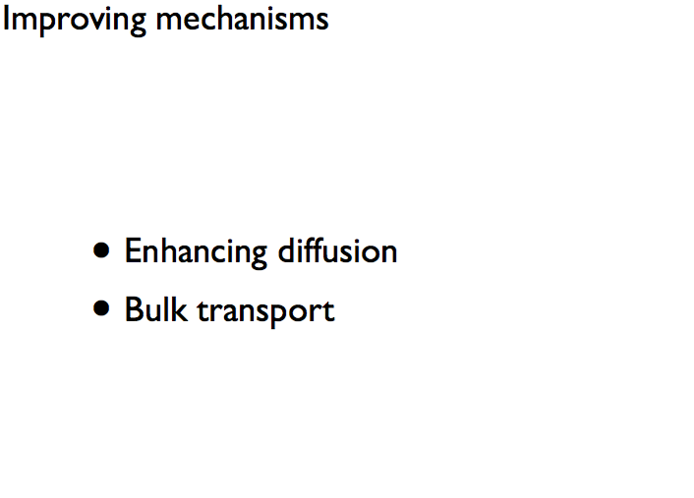

Slide 24
How Do Gills Work?
Gills are outgrowths of the body surface or throat, used for gas exchange in aquatic animals
Gills present an extremely large surface area for oxygen to diffuse across an extremely thin epithelium
Among invertebrates, the structure of gills is extremely diverse; gills can be external or internal
Fish gills are located on both sides of the head in teleosts consisting of four arches

Slide 25
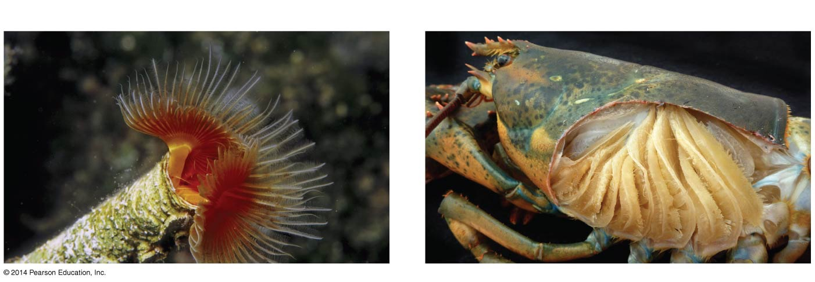

Figure 45.4
(a)
External gills are in direct contact with water.
(b)
Internal gills must have water brought to them.
External
gills
Internal gills
5 mm
1 cm
Notes:
FIGURE 45.4 Gills Can Be External or Internal.

Slide 26
How Do Fish Ventilate Their Gills?
The bony fish have internal gills
In such internal gills, water must be driven over them in the process of ventilation
Most fish ventilate their gills by opening and closing their mouths and the operculum, a stiff flap over the gills
Particularly fast swimmers force water through their gills by swimming with their mouths open
A process called ram ventilation

Slide 27
How Do Gills Work?
Movement of water over gills is in one direction
Long, thin structures called gill filaments extend from each gill arch
Each gill filament is composed of hundreds or thousands of gill lamellae—sheetlike structures
A bed of small blood vessels called capillaries runs through the lamellae
The water must flow over the gills in order for the gases to be exchanged

Slide 28
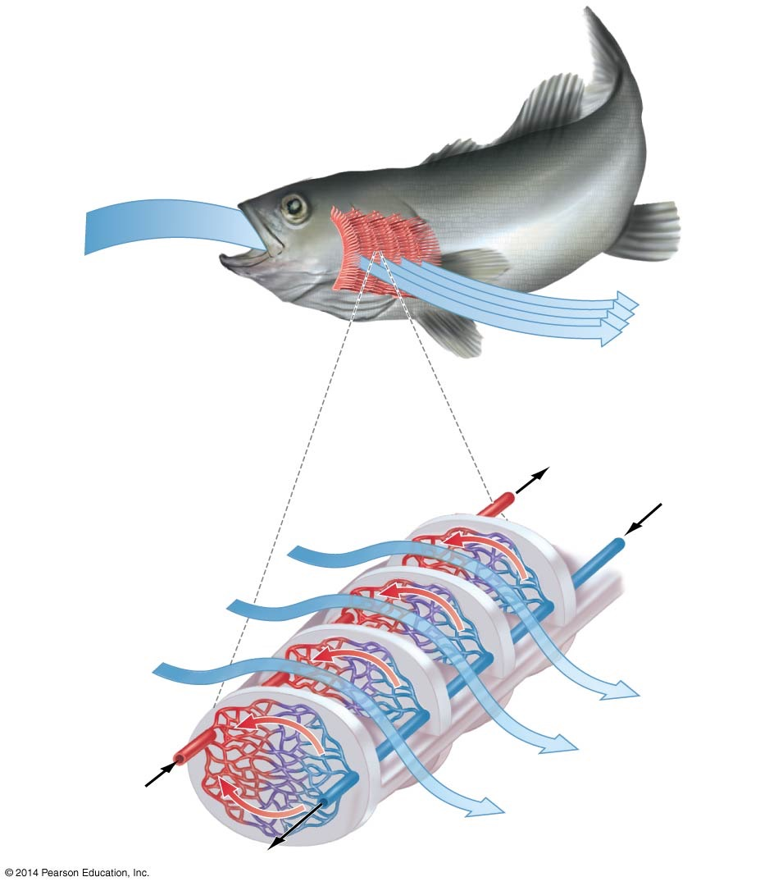
Figure 45.5
Each gill arch holds
many gill filaments
Water IN
The operculum
has been removed
to reveal the gills
Water OUT
Oxygen-
righ blood
to body
Oxygen-
poor blood
from heart
Detail of gill filament:
Oxygen-rich
water IN
Water flow
Gill lamella
Blood flow
Oxygen-poor
water OUT
Capillaries
Notes:
FIGURE 45.5 Fish Gills Are a Countercurrent Exchange System.

Slide 29
The Fish Gill Is a Countercurrent System
The flow of blood through the capillaries is in the opposite direction to the flow of water over the gill surface
This sets up a countercurrent exchange system in each lamella
This exchange system creates a large partial pressure of oxygen and the carbon dioxide in water over blood
The result is efficient exchange of gases over the gills

Slide 30
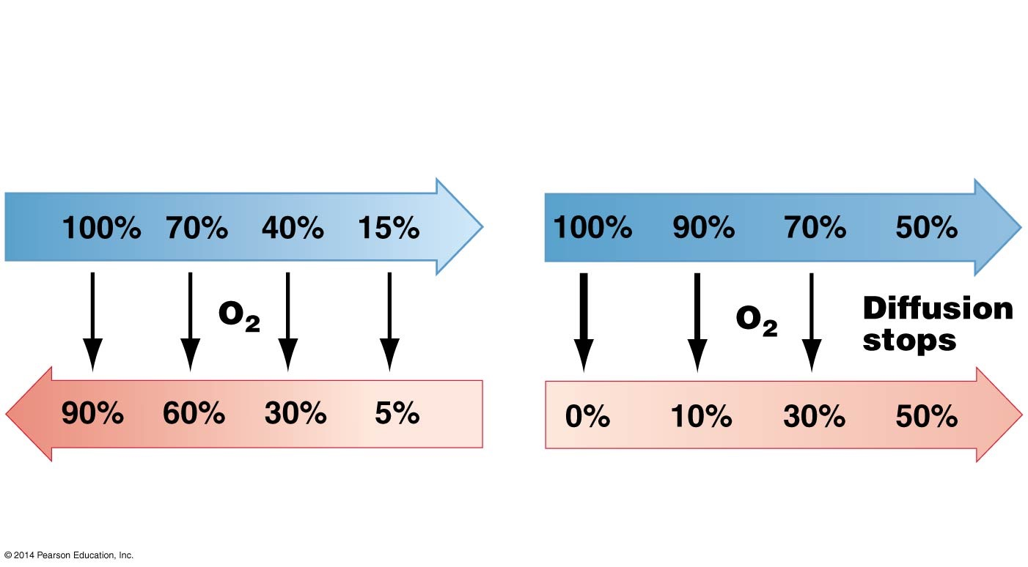
Figure 45.6
Countercurrent flow
(seen in fish gills)
Concurrent flow
(not seen in fish gills)
Water flow over lamellae
(% oxygen)
Water flow over lamellae
(% oxygen)
Blood flow through lamellae
(% oxygen)
Blood flow through lamellae
(% oxygen)
Notes:
FIGURE 45.6 Countercurrent Exchange Is Much More Efficient than Concurrent Exchange.

Slide 31
Gills / Ctenidium
advantages
disadvantages

Slide 32
How Do Insect Tracheae Work?
Insects have air-filled tubes called trachea
Trachea open to the outside through pores called spiracles
Air moves into the trachea and then by diffusion into the cells
In small insects, this is sufficient to exchange gases

Slide 33
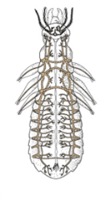
How Do Insect Tracheae Work?
Insects have air-filled tubes called trachea
Trachea open to the outside through pores called spiracles
Air moves into the trachea and then by diffusion into the cells
In small insects, this is sufficient to exchange gases

Slide 34
How Do Insect Tracheae Work?
In larger species, trachea alternately open and close as the wing muscles around them contract and relax
As a result, the volume of the tracheal system changes
As the volume changes, so does the pressure
Pressure and volume are inversely related
The movement of gases is also aided by larger trachea

Slide 35
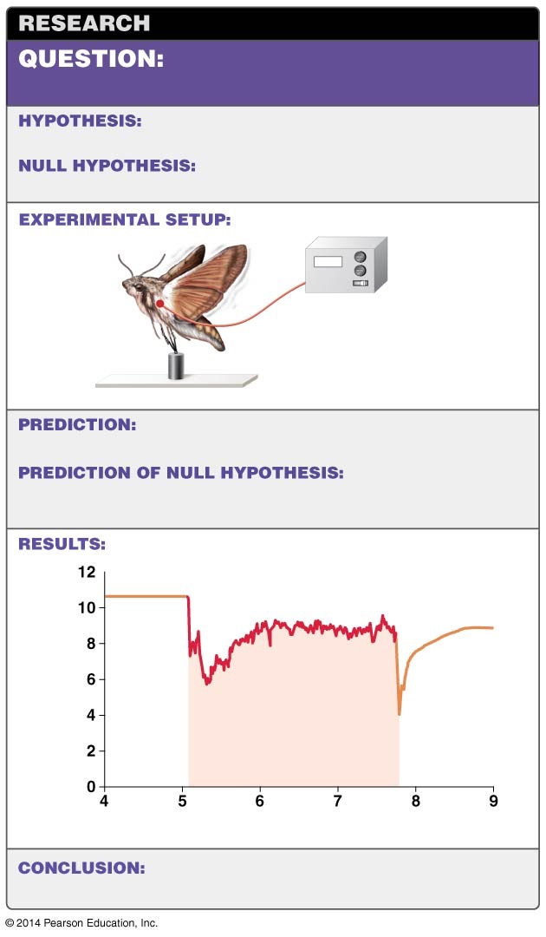
Figure 45.7
Does physical activity affect air
movement through the tracheal system?
Air moves through the tracheal system faster
during physical activity.
Physical activity does not affect the rate
of air movement.
Measure oxygen in
hawkmoth flight
muscle during rest
and during flight.
Tether
Flying will increase ventilation of tracheal system,
causing increase in P_{O2} in wing muscle.
Flying will not increase
ventilation of tracheal system; P_{O2} in flight muscle will decline
steadily during flight.
Flight
P_{O2} (kPa)
Recovery of
oxygen levels
as flying
continues
Initial drop
in oxygen
Rest
Rest
Time (min)
Muscular contractions may help ventilate the
tracheal system in at least some insects.
Notes:
FIGURE 45.7 Research Suggests the Tracheal System Is Ventilated during Movement.

Slide 36
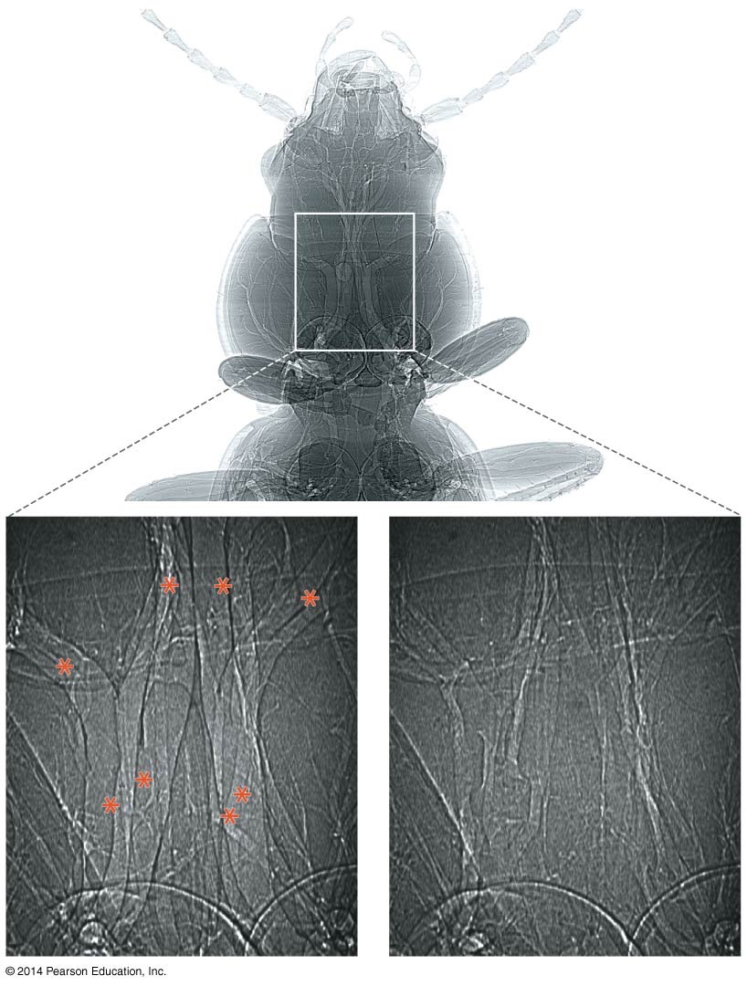
Figure 45.8
Ground beetle
Tracheae
1 mm
1 mm
Tracheae dilate when
muscles relax
Tracheae compress when
muscles contract
200 µm
Notes:
FIGURE 45.8 Tracheae Are Dilated and Compressed during Ventilation.

Slide 37
How Do Vertebrate Lungs Work?
In terrestrial animals, air enters the body through the mouth and nose
The trachea carries inhaled air to narrow tubes called bronchi
The bronchi branch off into even narrower tubes called bronchioles
The organ for gas exchange is the lung
The lung encloses the bronchioles and portions of the bronchi
Animals with lungs include some fish, amphibians, reptiles, birds, and mammals

Slide 38
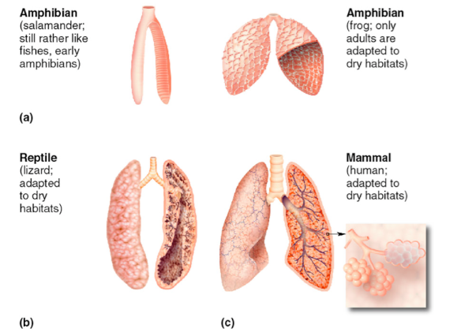

Slide 39
Lung Structure and Ventilation Vary among Species
In frogs and other amphibians, the lung is a simple sac lined with blood vessels
Mammalian lungs are divided into tiny sacs called alveoli, which greatly increase the surface area for gas exchange
Humans have approximately 150 million alveoli per lung

Slide 40
Lung Structure and Ventilation Vary among Species
Alveoli provide an interface between air and blood that consists of
A thin aqueous film
A layer of epithelial cells
Some extracellular matrix (ECM) material
The wall of a capillary

Slide 41
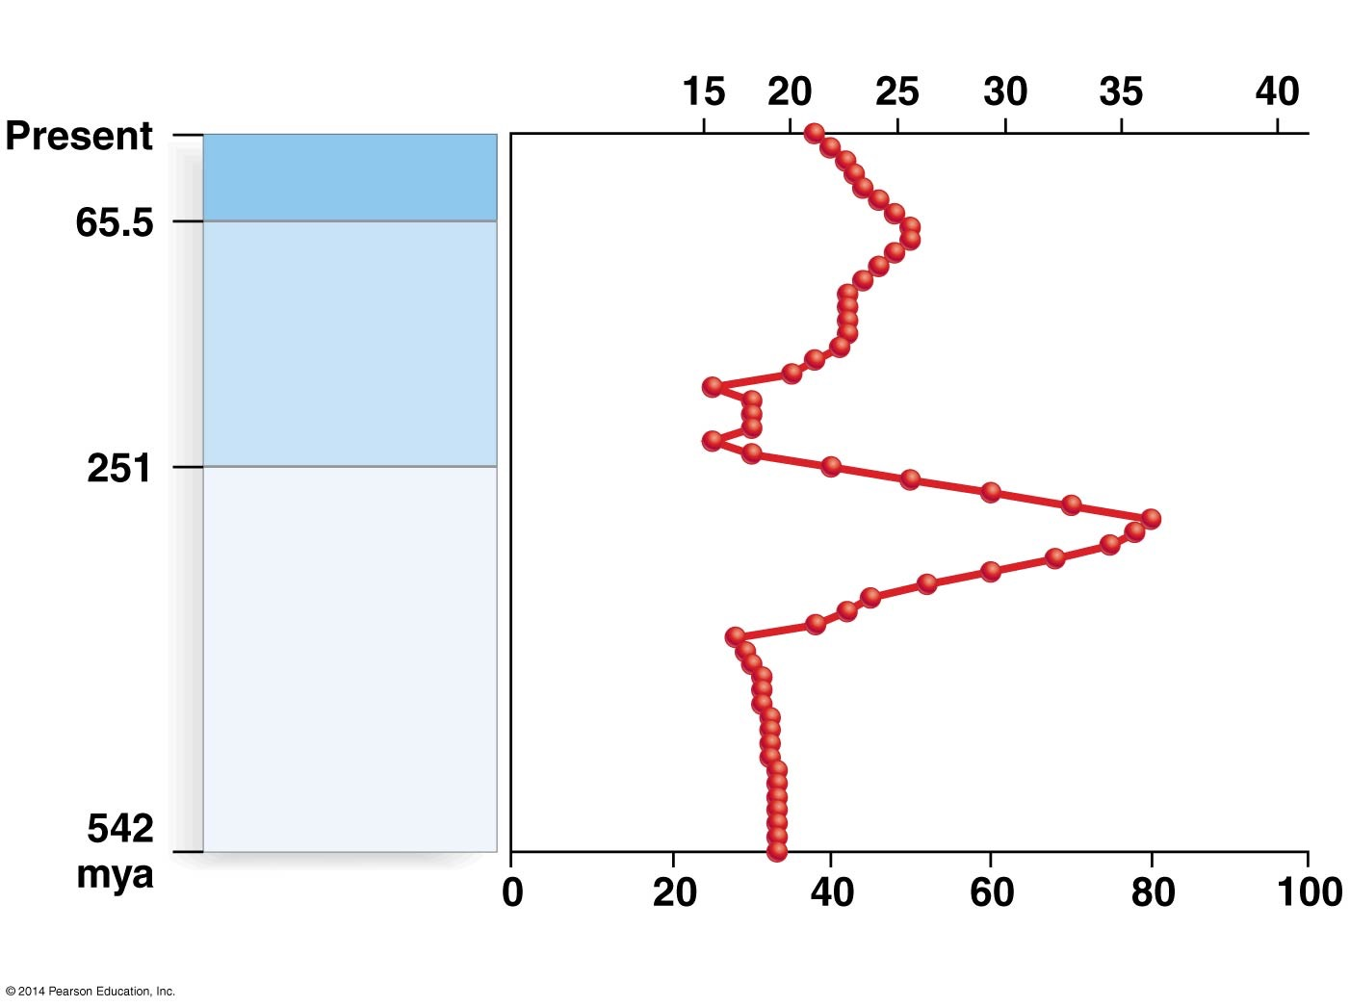
Figure 45.9
Percent O₂
Cenozoic Era
Mesozoic Era
Paleozoic Era
Mass O₂
Notes:
FIGURE 45.9 Atmospheric Oxygen Levels Peaked during the Paleozoic Era.

Slide 42
Lung Structure and Ventilation Vary among Species
Lung structure can vary among species and animal groups
In the simple lungs of snails and spiders, air movement takes place by diffusion only
In most amphibians, the lung is a simple air sac lined with blood vessels

Slide 43
Pumping Air
Vertebrates actively ventilate their lungs by pumping air via muscular contractions
There are two mechanisms for pumping air:
Positive pressure ventilation, used by frogs
Negative pressure ventilation, used by humans and other mammals

Slide 44
Ventilation of the Human Lung
The air inside the human lung is under negative pressure
The pumping action in humans is achieved by a muscle called the diaphragm

Slide 45
Ventilation of the Human Lung
Two steps are involved:
When the diaphragm moves down, the air in the chest cavity is lowered and air moves in
As the diaphragm relaxes, the chest cavity decreases and air is exhaled
This is a passive process driven by the elastic recoil of the lungs and chest wall as the diaphragm and rib muscles relax

Slide 46
The Capacity of the Human Lung
About 450 mL of air moves into and out of the lungs in an average breath
Only about two-thirds of this volume actually participates in gas exchange, however, because 150 mL of the air occupies dead space—portions of the air passages, such as the trachea and bronchi, that do not have a respiratory surface

Slide 47
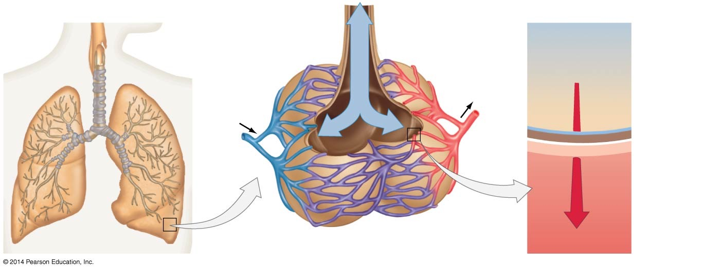
Figure 45.10
(a)
Airways into the human lungs
(b)
Alveoli
(c)
The alveolar gas-exchange surface
Smallest
bronchiole
Air
Trachea
Air
Oxygen-rich
blood out
Oxygen
Aqueous film
Lung
Epithelium
of alveolus
Oxygen-poor
blood in
0.2
µm
ECM
Wall of
capillary
Bronchi
Bronchioles
Alveolus
Capillaries
Blood
Notes:
FIGURE 45.10 Lungs Offer a Thin Membrane with a Large Surface Area for Gas Exchange between Air and Blood.

Slide 48
Ventilation in Birds
Birds are able to extract enough oxygen for extremely long flights and flights at high elevations
There are four general steps to ventilation in birds:
During inhalation, air flows through the trachea into two large air sacs
During exhalation, air flows from the air sacs and into the posterior of the lung, known as the parabronchi

Slide 49
Ventilation in Birds
During the second inhalation, air moves to the anterior parabronchi
During the second exhalation, air moves out to the atmosphere
Air flow through the avian lung is unidirectional

Slide 50
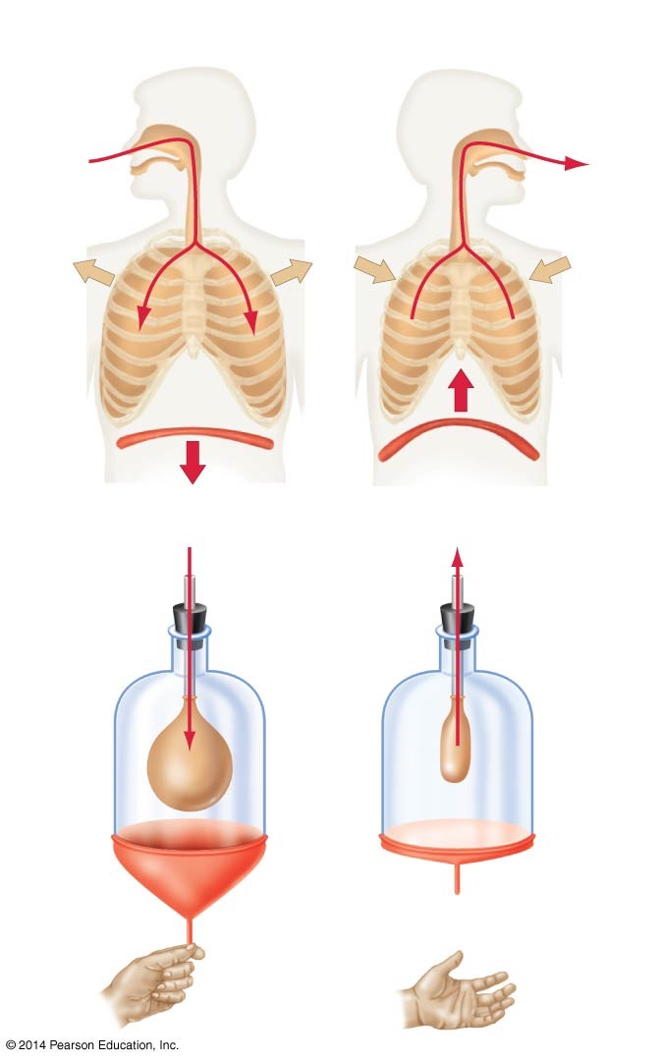
Figure 45.11
(a)
Lungs expand and contract in response to changes in
pressure inside the chest cavity.
INHALATION
EXHALATION
Pressure
more
negative
Pressure
less
negative
Diaphragm
(b)
Ventilatory forces can be modeled by a balloon in a jar.
Pressure
more
negative
Pressure
less
negative
When the
diaphragm
is pulled
down, the
balloon inflates.
When the
diaphragm
is released,
the balloon
deflates.
Notes:
FIGURE 45.11 Changes in the Volume of the Chest Cavity Drive Negative Pressure Ventilation.

Slide 51
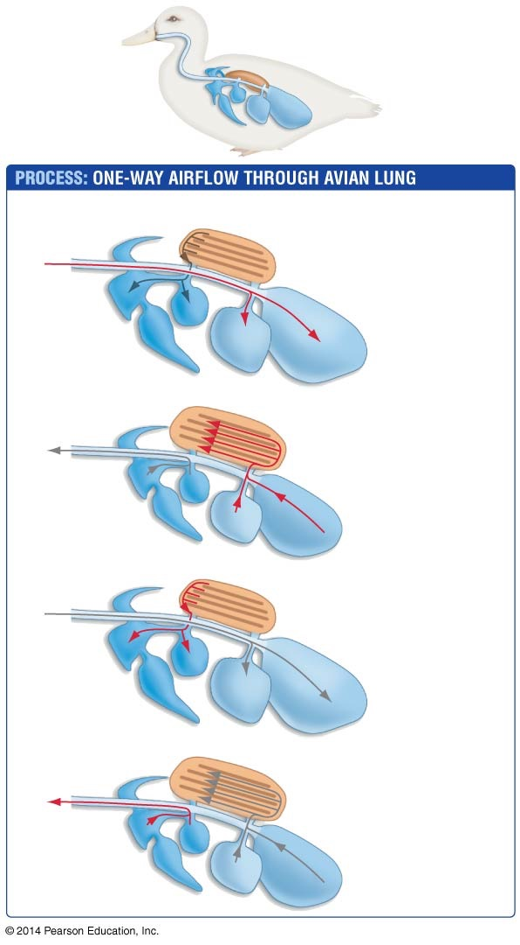
Figure 45.12
Lung, where
gas exchange
occurs
Air sacs enable
one-way airflow
through lung
Follow one breath (in red) through the avian respiratory system
Trachea
Inhalation
1. Posterior
air sacs fill
with outside air.
Posterior air sacs
Parabronchi
Exhalation
Lung
2. Lungs fill
with air from
posterior sacs.
Inhalation
3. Anterior air
sacs fill with
air from lungs.
Anterior
air sacs
Exhalation
4. Anterior air
sacs empty.
Notes:
FIGURE 45.12 Air Flows in One Direction through the Bird Lung, Maximizing Gas Exchange.

Slide 52
Ventilation in Birds
Three features make the avian ventilatory system efficient:
Dead space in bird lungs is restricted to a short stretch of trachea, between the mouth and anterior air sacs
Birds exchange gases during both inhalation and exhalation
The capillaries in bird lungs cross the parabronchi in a very efficient perpendicular arrangement

Slide 53
Homeostatic Control of Ventilation
At rest, the mammalian rate of breathing is established by the medullary respiratory center, an area at the base of the brain
The medullary respiratory center stimulates the rib and diaphragm muscle to expand and contract

Slide 54
Homeostatic Control of Ventilation
During exercise, muscles take up more oxygen from the blood
The partial pressure of oxygen in the blood (PO₂) decreases
At the same time, the muscles release larger amounts of carbon dioxide, increasing its partial pressure (PCO₂) in the blood

Slide 55
Homeostatic Control of Ventilation
Increased CO₂ reacts with water in the blood and cerebrospinal fluid (CSF) to form carbonic acid, H₂CO₃, which quickly dissociates into a hydrogen ion, H⁺, and a bicarbonate ion, HCO₃⁻
CO₂ + H₂O ↔ H₂CO₃ ↔ H⁺ + HCO₃⁻
The release of hydrogen ions lowers the blood and CSF pH, which is sensed by specialized neurons, leading to the medullary respiratory center and increasing the breathing rate, which returns the partial pressures of these two gases to resting levels

Slide 56
Homeostatic Control of Ventilation
These neurological signals cause the breathing rate to increase
This increases the rate of oxygen delivery to tissues and muscles
The rate of elimination of carbon dioxide is also increased
The partial pressures of oxygen and carbon dioxide are restored, even during intense exercise

Slide 57
How Are Oxygen and Carbon Dioxide Transported in Blood?
Blood is a connective tissue consisting of cells and water
The blood has many functions:
Transport oxygen and carbon dioxide
Transport nutrients to cells from the digestive system
Conveys hormones to target tissues and organs
Delivers cells of the immune system
Distributes heat
The water portion is often referred to as an extracellular matrix, or simply the plasma

Slide 58
Cellular Components of the Blood
The blood has cellular components:
Platelets are cell fragments that minimize blood loss
White blood cells (WBCs) are part of the immune system
Red blood cells (RBCs) transport oxygen from the lungs to body tissues, and participate in transporting carbon dioxide from tissues to lungs
In humans, red blood cells make up 99.9% of the formed elements

Slide 59
Structure and Function of Hemoglobin
Red blood cells contain an oxygen-carrying molecule called hemoglobin
Hemoglobin consists of four polypeptide chains, each of which binds to a nonprotein group called a heme
Each heme contains an iron ion (Fe²⁺) that can bind to an oxygen molecule
Each hemoglobin molecule can thus bind up to four oxygen molecules
In blood, 98.5% of the oxygen is bound to hemoglobin
The other 1.5% is dissolved in plasma

Slide 60
Hemoglobin - is it important?

Slide 61
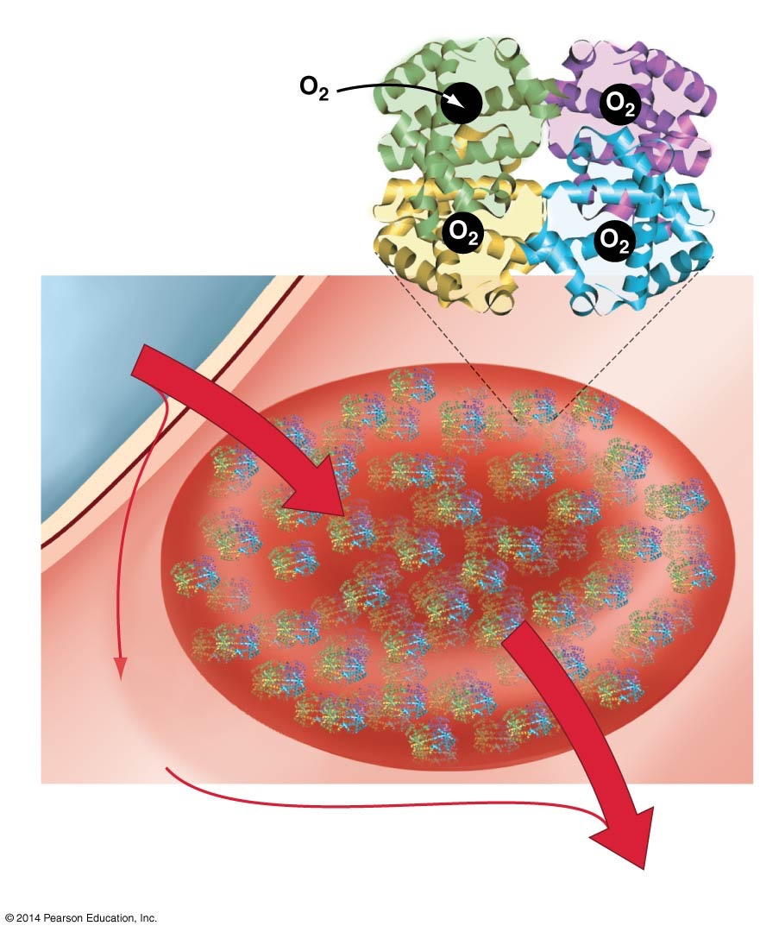


Figure 45.13
Each hemoglobin
molecule can
bind up to four
molecules of
oxygen
Hemoglobin
O₂
O₂ from
lung
98.5% of oxygen
binds to hemoglobin
in red blood cells
1.5% of oxygen
dissolves in
blood plasma
The rate of unloading depends on the
partial pressure of oxygen in the tissue
O₂ to tissues
Notes:
FIGURE 45.13 Hemoglobin Transports Oxygen to Tissues.

Slide 62
Hemoglobin Unloads Oxygen to Muscle Tissue
Blood leaving human lungs has a PO₂ greater than that of muscles and other tissues
This difference creates a diffusion gradient that unloads O₂ from hemoglobin to the tissues

Slide 63
Hemoglobin Unloads Oxygen to Muscle Tissue
The oxygen-hemoglobin equilibrium curve, or oxygen dissociation curve, plots the percentage saturation of hemoglobin in RBCs versus the PO₂ in blood within tissues
The curve is sigmoidal, or S-shaped, which is significant due to the binding of each successive oxygen molecule
This represents a conformational change in the protein, which aids in the addition of more oxygen
This phenomenon is called cooperative binding

Slide 64
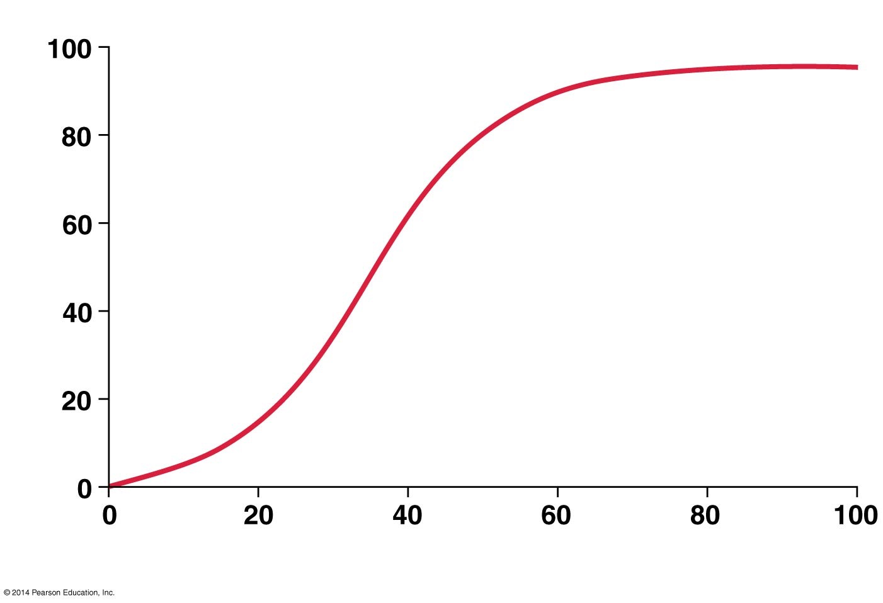
Figure 45.14
% O₂ changes
slowly
O₂ saturation (%) of hemoglobin
In this part of the graph, a
small change in PO₂ leads to
a large change in how much
O₂ unloads from hemoglobin
% O₂
changes
slowly
PO₂ (mm Hg) in blood within tissue
High Demand
Notes:
FIGURE 45.14 The Oxygen–Hemoglobin Equilibrium Curve Is Sigmoidal.

Slide 65
Why Is Cooperative Binding Important?
Cooperative binding makes hemoglobin exquisitely sensitive to changes in the PO₂ of tissues
In other words, in response to a relatively small change in tissue PO₂, there is a relatively large change in the percentage saturation of hemoglobin

Slide 66
Figure 45.14
% O₂ changes
slowly
O₂ saturation (%) of hemoglobin
In this part of the graph, a
small change in PO₂ leads to
a large change in how much
O₂ unloads from hemoglobin
% O₂
changes
slowly
PO₂ (mm Hg) in blood within tissue
High Demand
Notes:
FIGURE 45.14 The Oxygen–Hemoglobin Equilibrium Curve Is Sigmoidal.

Slide 67
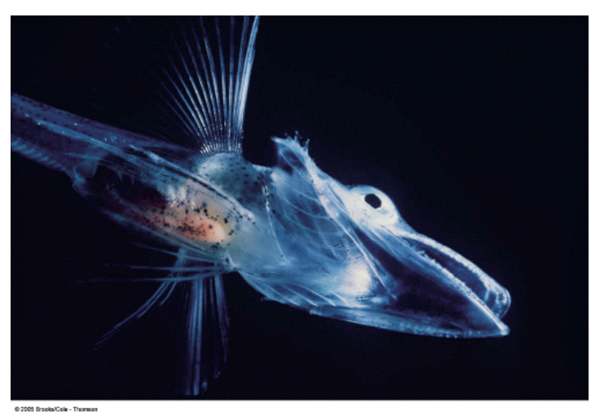

Slide 68
The Bohr Shift
Hemoglobin is sensitive to changes in pH and temperature
Decreases in pH and increases in temperature alter hemoglobin’s conformation such that it is more likely to release O₂ at all values of PO₂
Note: A conformational change means a change in the shape of the molecule
This phenomenon is known as the Bohr shift
The Bohr shift makes hemoglobin more likely to release oxygen during exercise in which PCO₂ is high, pH is low, and tissues are under oxygen stress

Slide 69
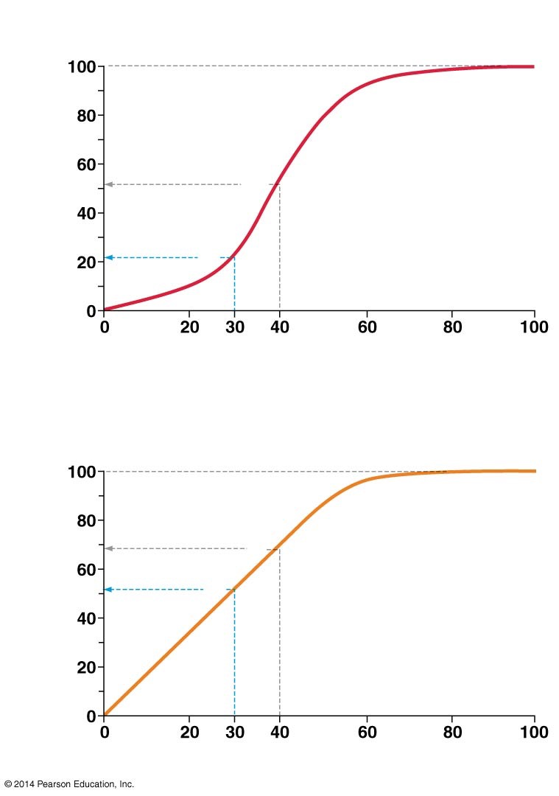
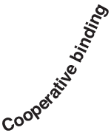
Figure 45.15
(a) With cooperative binding, large amounts of O₂
are delivered to resting and exercising tissues.
Resting
O₂ saturation
(%) of hemoglobin
Exercising
PO₂ (mm Hg) in blood within tissue
(b) Without cooperative binding, smaller amounts of O₂
would be delivered to resting and exercising tissues.
Resting
Exercising
O₂ saturation
(%) of hemoglobin
Noncooperative binding
PO₂ (mm Hg) in blood within tissue
Notes:
FIGURE 45.15 Cooperative Binding of O₂ by Hemoglobin Results in Greater O₂ Delivery than Noncooperative Binding.

Slide 70
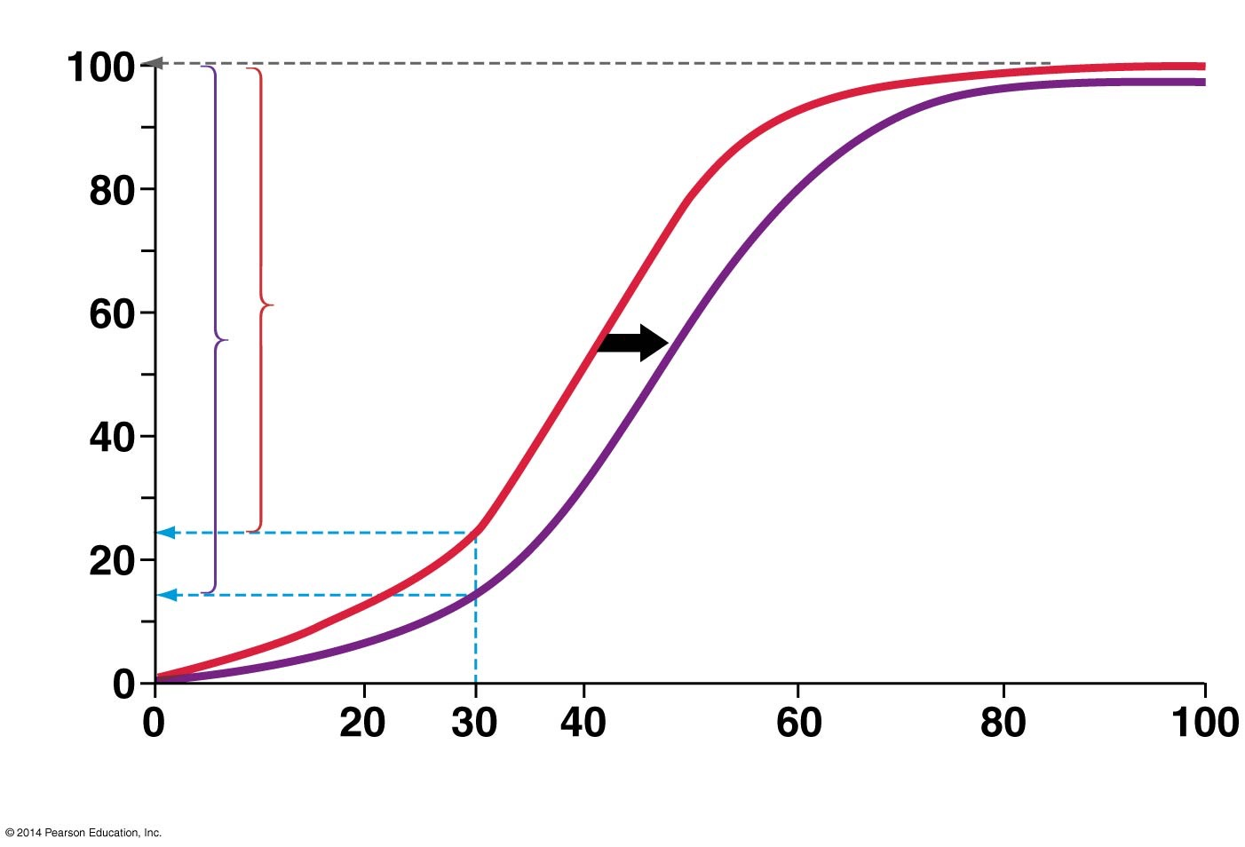
Figure 45.16
pH 7.4
pH 7.2
Bohr shift
O₂ saturation (%) of hemoglobin
PO₂ (mm Hg) in blood within tissue
Notes:
FIGURE 45.16 The Bohr Shift Makes Hemoglobin More Likely to Release Oxygen to Tissues with Low pH.

Slide 71
Comparing Hemoglobins
Hemoglobin molecules from different individuals or species may vary in ways that affect fitness
One example is fetal hemoglobin vs. mother’s hemoglobin
Fetal hemoglobin has a higher affinity for oxygen than adult hemoglobin
Fetal hemoglobin is encoded differently than the adult hemoglobin
As a result, oxygen is transferred from the mother’s blood to the fetus’s blood, thus ensuring an adequate supply of oxygen as the fetus develops

Slide 72
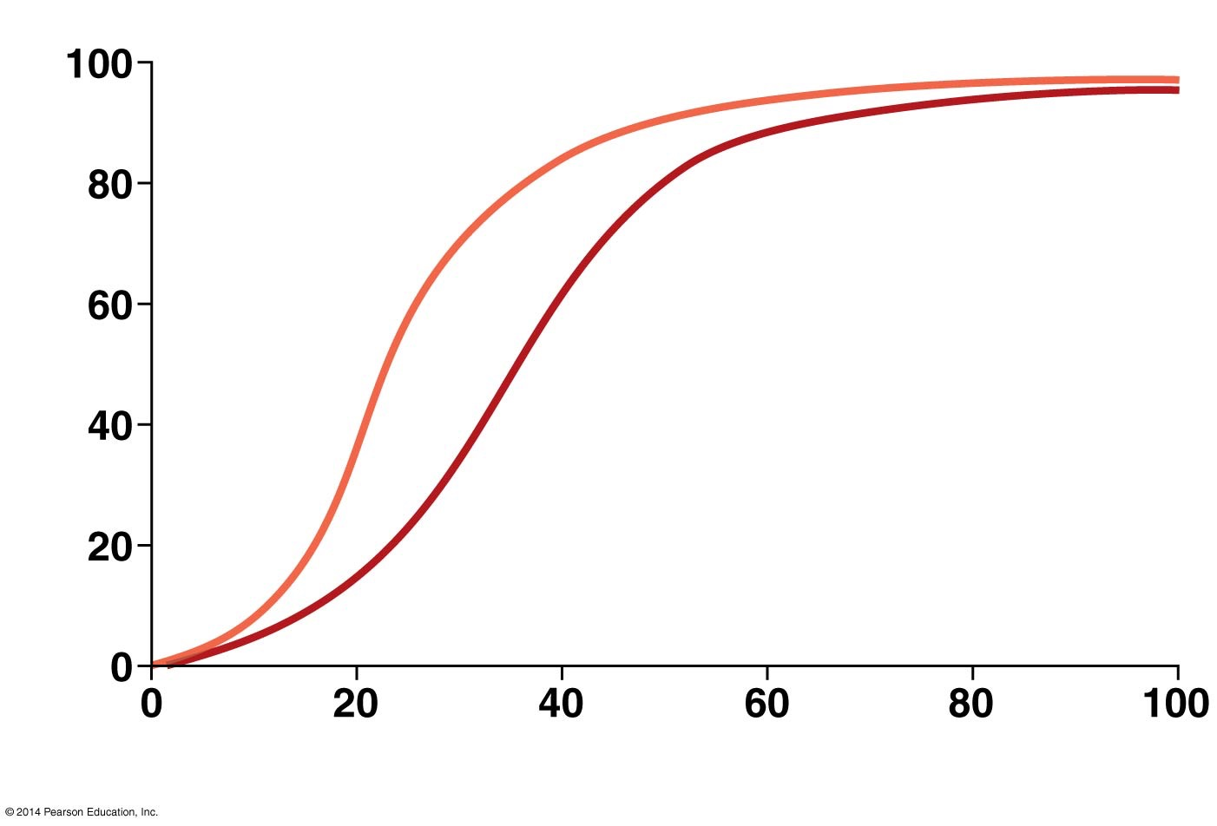
Figure 45.17
Fetal
hemoglobin
O₂ saturation (%) of hemoglobin
Adult (maternal)
hemoglobin
PO₂ (mm Hg) in blood within tissue
Notes:
FIGURE 45.17 Fetal Hemoglobin Binds Oxygen More Tightly than Maternal Hemoglobin.

Slide 73
CO₂ Transport and the Buffering of Blood pH
CO₂ that is produced by cellular respiration enters the blood and RBCs
Where it is quickly converted to bicarbonate ions and protons in a reaction catalyzed by the enzyme carbonic anhydrase
Carbonic anhydrase catalyzes the formation of carbonic acid from carbon dioxide in water
CO₂ that diffuses into red blood cells is quickly converted to bicarbonate ions and protons
Most CO₂ is transported in blood (specifically in plasma) in the form of the bicarbonate ion, HCO₃⁻

Slide 74
Carbonic Anhydrase and Hemoglobin
Carbonic anhydrase activity in red blood cells is important for two reasons:
The protons produced by the carbonic anhydrase reaction induce the Bohr shift, which makes hemoglobin more likely to release oxygen
The PCO₂ in blood drops when CO₂ is converted to bicarbonate, maintaining a strong partial-pressure gradient favoring the entry of CO₂ into red blood cells

Slide 75
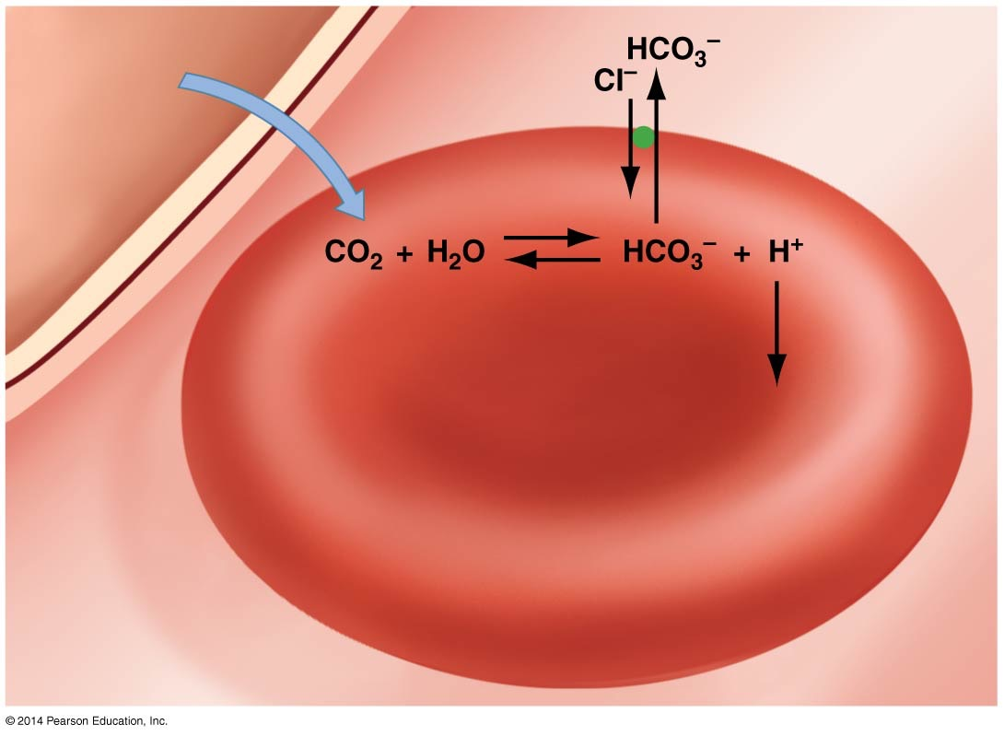
Figure 45.18
Transport
protein in
cell membrane
Transported
in plasma
CO₂ from
tissue
Carbonic
anhydrase
Binds to
hemoglobin
Red blood cell
Plasma
Notes:
FIGURE 45.18 Carbonic Anhydrase Is Key to CO₂ Transport in Blood.

Slide 76
When Blood Returns to the Lungs
Much of the H⁺ produced by the dissociation of carbonic acid is taken up by hemoglobin
Therefore, hemoglobin also acts as a buffer, minimizing changes in pH
In the alveoli, a partial-pressure gradient favors the diffusion of CO₂ from plasma and RBCs to the atmosphere

Slide 77
When Blood Returns to the Lungs
Hemoglobin releases protons, which combine with bicarbonate to form CO₂
Which then diffuses into the alveoli and is exhaled from the lungs
Hemoglobin picks up O₂ during inhalation, and the cycle begins again

Slide 78

Gas Exchange in the Lungs and Tissues
Web Activity: Gas Exchange in the Lungs and Tissues

Slide 80
Circulation
Animals maximize the surface area available for diffusion of gases and other key solutes in a variety of ways:
Tiny animals have a small enough volume that diffusion over their body surface is adequate to keep them alive
Tapeworms and flatworms have a high ratio of surface area to volume
The highly folded gastrovascular cavity of jellyfish offers a large surface area for molecular exchange
Diffusion in roundworms is accomplished by muscular contractions

Slide 81
Circulation
Larger animals require a circulatory system in order to achieve a large ratio of surface area to volume

Slide 82
Types of Circulatory Systems
There are two types of circulatory systems:
Open
Closed

Slide 83
What Is an Open Circulatory System?
In the open system, the hemolymph is pumped throughout the body in open vessels
The hemolymph comes in direct contact with body tissues
The open system is characteristic of invertebrates
The hemolymph is pumped by an organ called the heart

Slide 84
What Is a Closed Circulatory System?
In the closed system, blood flows in a continuous circuit of closed vessels
Pressure provided by the pumping action of the heart
Closed systems are characteristic of vertebrates

Slide 85
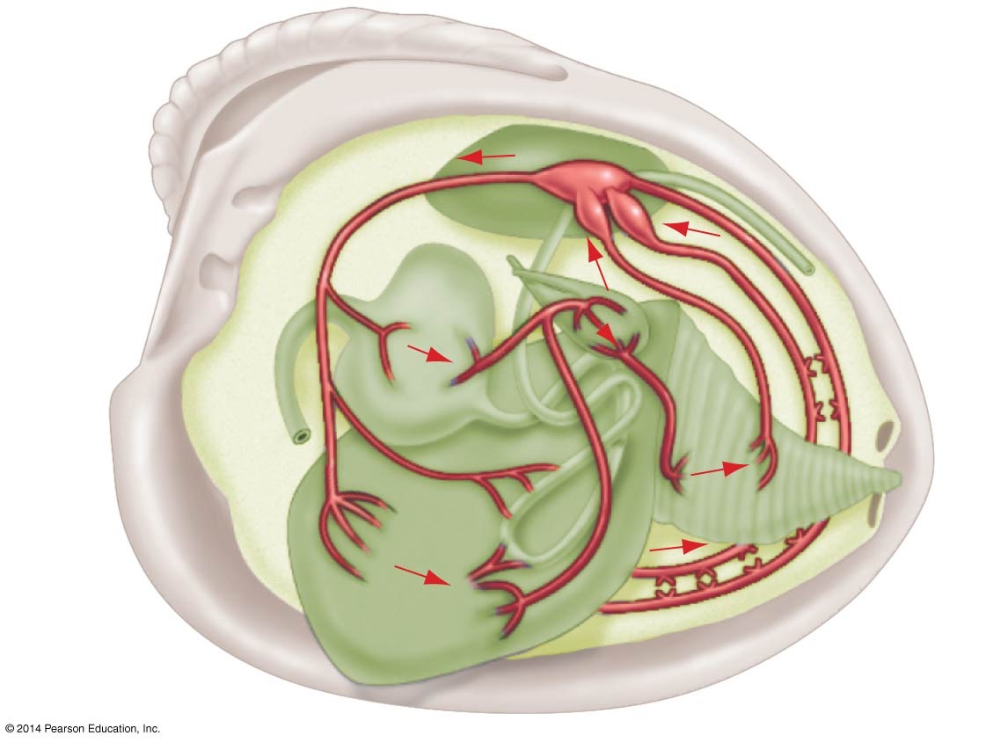
Figure 45.19
Clam
Heart
Vessel
carrying
hemolymph
Stomach
Gills
Foot
Notes:
FIGURE 45.19 Clams Have Open Circulatory Systems.

Slide 86
Problems with an Open Circulatory System
A limitation of the open circulatory system is that, without discrete, continuous vessels, the flow of hemolymph cannot be directed toward tissues that have a high oxygen demand and CO₂ buildup
Crustaceans are an important exception to this rule; they have a network of small vessels that can preferentially send hemolymph to tissues with the highest oxygen demands

Slide 87
Lineages with a Closed Circulatory System
Closed circulatory systems are found in vertebrates and a few other lineages where individuals tend to be active
For example, annelids, most of which live as active burrowers and hunters, are able to obtain and circulate enough oxygen to support intense muscular activity
A similar situation occurs in squid, octopuses, and other cephalopods that hunt down prey

Slide 88
Lineages with a Closed Circulatory System
Closed circulatory systems contain an array of blood vessels
Each has a distinct structure and function

Slide 89
Types of Blood Vessels
Blood vessels are classified as arteries, capillaries, or veins
Arteries are tough, thick-walled vessels that take blood away from the heart under high pressure
Small arteries are called arterioles
Capillaries are the smallest vessels. Their walls are just one cell thick, allowing gases and other molecules to exchange with tissues in networks called capillary beds
Veins are vessels that return blood to the heart(s) under low pressure
Small veins are called venules

Slide 90
The Structure of Blood Vessels
The structure of arteries, capillaries, and veins correlates closely with their function in a closed circulatory system
The walls of the arteries and arterioles are composed of smooth muscle tissue that allows for the elasticity of the vessels
The aorta, a large vessel, generally receives blood from the heart
Has elastic walls, allowing it to expand when blood enters it under high pressure from the heart

Slide 91
The Structure of Blood Vessels
Arterioles have muscle fibers called sphincters wrapped around their circumference
The sphincters allow the diameter of the vessel to be carefully regulated in response to signals from the nervous system

Slide 92
Capillaries and Veins
Capillaries are where gases, nutrients, and wastes are exchanged between the blood and other tissues
They are extremely thin
They form an extremely dense network throughout the body
Veins have
Much thinner walls
Much larger interior diameters than arteries
Because blood is under relatively low pressure by the time it exits the tissues

Slide 93
Veins
Veins are compressed by muscle activity in the extremities, which helps speed the return of blood to the heart
Larger veins also contain valves, thin flaps of tissue that prevent any backflow of blood
All veins contain some muscle fibers, which contract in response to signals from the nervous system
Blood pressure in a closed circulatory system is regulated, in part, by active adjustment of the volume of blood in the veins

Slide 94
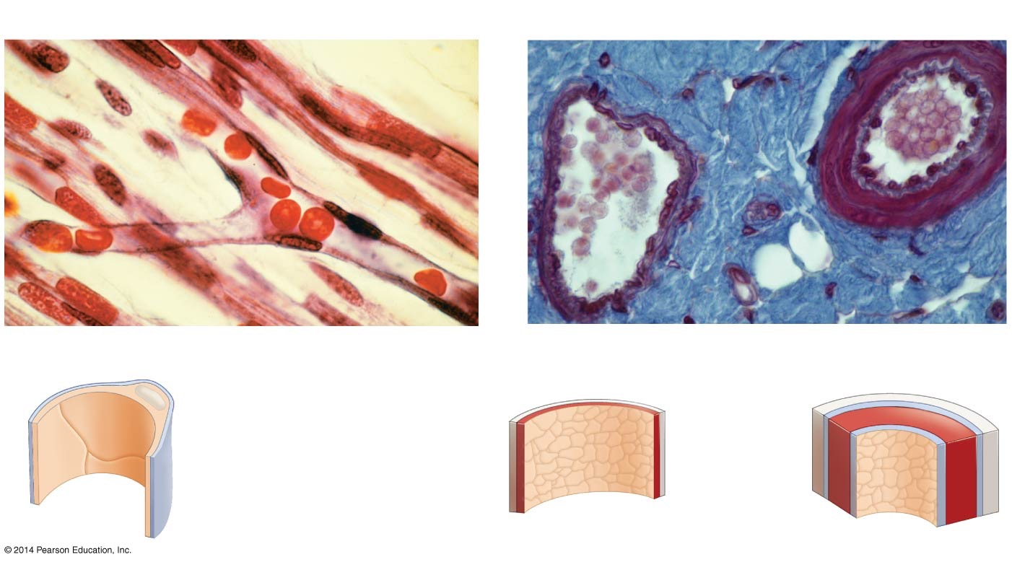
Figure 45.20
(a) Capillaries are small and extremely thin walled.
(b) Veins and arteries differ in structure.
Red
blood
cells
Red
blood
cells
10 µm
20 µm
Capillary
Vein
(Small-sized)
Artery
(Small-sized)
Nucleus
Fibrous tissue
Endothelial cells
Muscle tissue
Basement membrane
Elastic tissue
Endothelium
Notes:
FIGURE 45.20 The Structures of Capillaries, Veins, and Arteries Reflect Their Different Functions.

Slide 95
What Is Interstitial Fluid?
The area between cells is called the interstitial space
The fluid that leaks into it is interstitial fluid
Interstitial fluid builds up because of two forces:
There is an outward-directed hydrostatic force in capillaries, created by the pressure on blood generated by the heart
There is an inward-directed osmotic force in capillaries, created by the higher concentration of solutes in the blood plasma than in the interstitial space

Slide 96
Collecting the Interstitial Fluid
The interstitial fluid that is not reclaimed in the capillary is collected in the lymphatic system
A collection of thin-walled, branching tubules called lymphatic ducts or vessels
Interstitial fluid that enters the lymphatic ducts is called lymph
Three actions of the lymphatic duct:
Permeate all tissues
Eventually join with one another to form larger vessels
Return excess interstitial fluid, in the form of lymph, to the major veins entering the heart

Slide 97
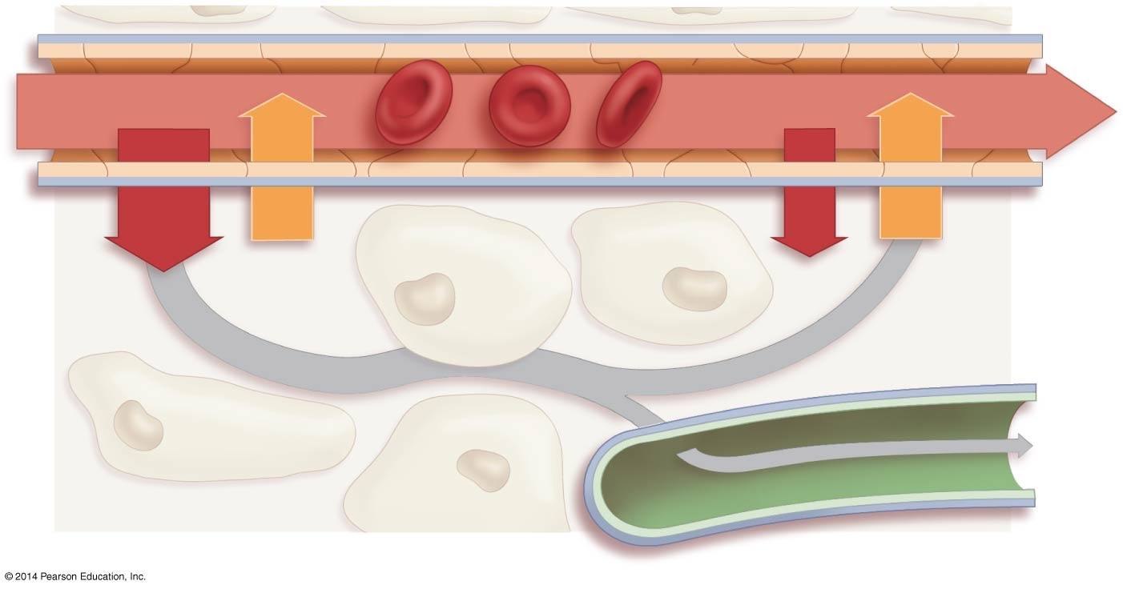
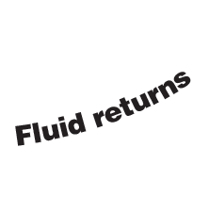
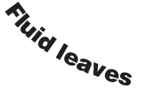
Figure 45.21
Blood enters capillary from arteriole
Blood leaves capillary to venule
Blood pressure
32 mmHg
Blood pressure
15 mm Hg
Blood inside capillary
Net pressure 10 mm Hg out
Net pressure 7 mm Hg in
Osmotic
pressure
22 mm Hg
Osmotic
pressure
22 mm Hg
Excess fluid in interstitial
space enters lymphatic duct
Lymph
leave
tissue
Lymphatic
duct
Interstitial fluid
Notes:
FIGURE 45.21 Pressure Differences in Capillaries Create Interstitial Fluid and Lymph.

Slide 98
How Does the Heart Work?
In animals with closed circulatory systems, the heart contains at least two chambers:
The atrium receives blood returning from circulation
The ventricle generates force to propel the blood through the system

Slide 99
How Does the Heart Work?
Atria are separated from ventricles by atrioventricular valves
There have been two distinct trends as vertebrates diversified:
The number of distinct heart chambers has increased
In some animals, one circuit serves the entire body; in more complex vertebrates, there are two circuits

Slide 100
More Complex Circulatory Systems
Fish have a two-chambered heart and single circulatory circuit to both gills and the rest of the body
Circulation in land-dwelling vertebrates is much more affected by the force of gravity
Land vertebrates evolved two separate pumping circuits:
The pulmonary circulation is a lower-pressure circuit to and from the lungs
The systemic circulation is a higher-pressure circuit to and from the rest of the body

Slide 101
Circulatory Systems Have Become More Complex
The pulmonary and systemic circulations are completely separated in the four-chambered hearts of birds and mammals, but are only partially separated in the three-chambered hearts of amphibians and the “five-chambered” hearts of turtles and lizards
Some animals have a bypass vessel running from the right ventricle directly into the systemic circulation
It shunts blood from the pulmonary to the systemic circulation when an animal is underwater, greatly reducing blood flow to the lungs when the animal is not breathing

Slide 102
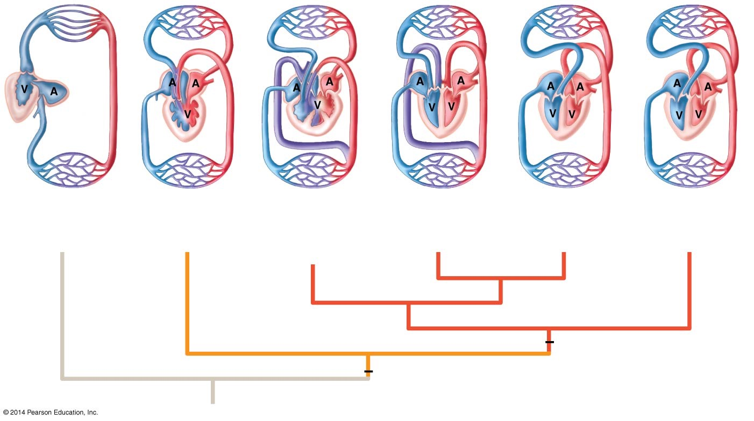
Figure 45.22
Gills
Lung
Lung
Lung
Lung
Lung
Body
Body
Body
Body
Body
Body
1 circuit
“2-chambered” heart
2 circuits
“3-chambered” heart
2 circuits
“3-chambered” heart
2 circuits
“4-chambered” heart
2 circuits
“4-chambered” heart
2 circuits
“4-chambered” heart
Fish
Amphibians
Turtles, lizards,
snakes
Crocodilians
Birds
Mammals
Ventricle divided
(partially or completely)
Two circulatory circuits
Notes:
FIGURE 45.22 As Vertebrate Circulatory Systems Evolved, the Number of Atria and Ventricles Increased.

Slide 103
The Human Heart and the Flow of Blood
The specific sequence of the flow of blood in the human heart:
Blood returns from the body to the right atrium
Blood enters the right ventricle through the right atrioventricular (AV) valve
Blood is pumped through the pulmonary valve, into the pulmonary artery, and to the lungs
Blood returns from the lungs, via the pulmonary veins, to the left atrium
Blood enters the left ventricle through the left AV valve
Blood is pumped through the aortic valve, into the aorta, and to the body

Slide 104
The Return of Blood to the Heart
The human circulatory system returns oxygen-depleted blood from the body to the right atrium of the heart through two large veins called the inferior and superior venae cavae
When the right atrium contracts, this deoxygenated blood is sent to the right ventricle, which then contracts, sending blood to the lungs via the pulmonary artery

Slide 106
The Flow of the Oxygenated Blood
After blood has circulated through the capillary beds in the lungs’ alveoli and becomes oxygenated, it returns to the heart through the pulmonary veins
The oxygenated blood enters the left atrium, which contracts and pushes the blood into the left ventricle

Slide 107
Anatomy of the Heart
BLAST Animation: Anatomy of the Heart

Slide 108
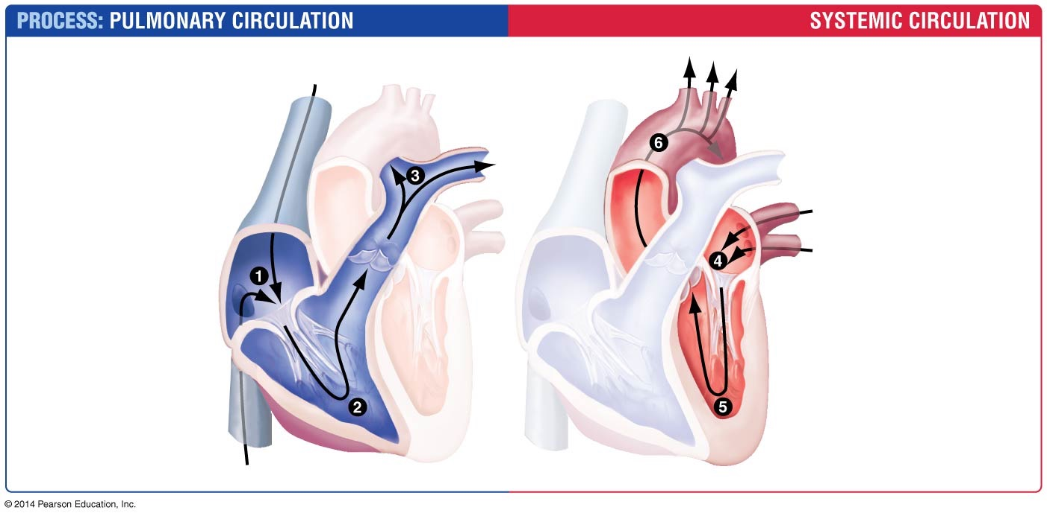
Figure 45.23
1. Blood enters
right atrium on
return from body.
4. Blood returns to left
atrium from lungs.
Aorta
5. Blood enters left
ventricle.
2. Blood enters
right ventricle.
Superior
vena cava
Pulmonary
veins
6. Blood is pumped
to body from left
ventricle.
3. Blood is
pumped to lungs
from right
ventricle.
Pulmonary
artery
...back to step 1
...on to step 4
Right
atrium
Pulmonary
valve
Aortic
valve
Left
atrium
Right
atrioventricular
(AV) valve
Left
atrioventricular
(AV) valve
Inferior
vena cava
Right
ventricle
Left
ventricle
Notes:
FIGURE 45.23 The Human Heart Maintains Separation of Oxygenated and Deoxygenated Blood.

Slide 109
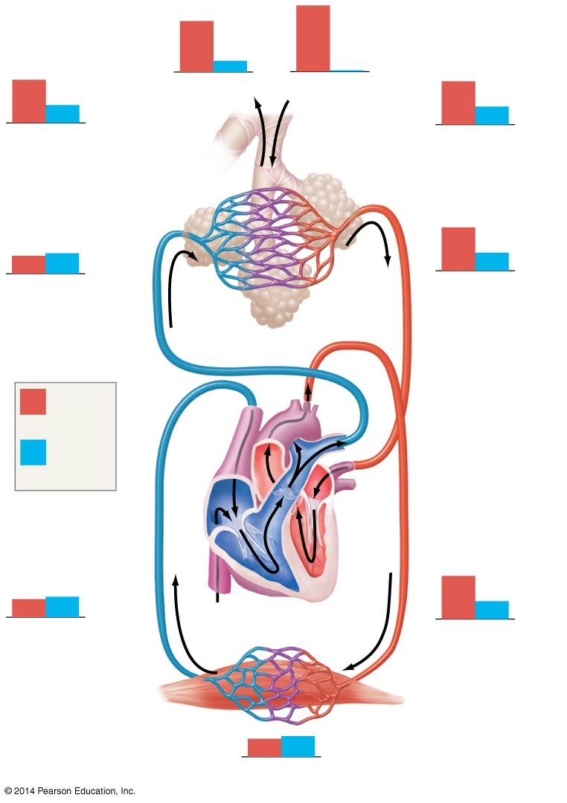
Figure 45.24
120
27
160
0.3
104
9. Exhaled air
1. Inhaled air
104
40
40
8. Alveolar
space
(in lungs)
2. Alveolar
space
(in lungs)
40
45
104
40
7. Blood
entering alveolar
capillaries
3. Blood
leaving alveolar
capillaries
Pulmonary circulation
P_{O2}
Aorta
(mm Hg)
Pulmonary
artery
P_{CO2}
(mm Hg)
Pulmonary
vein
Venae
cavae
40
45
104
40
6. Blood
leaving tissue
capillaries
Systemic circulation
4. Blood
entering tissue
capillaries
<40
>45
5. Tissues
Notes:
FIGURE 45.24 Partial Pressures of Gases Vary throughout the Human Circulatory System.

Slide 110
The Cardiac Cycle
Signals from the sinoatrial (SA) node ensure that the atria contract simultaneously, then relax
Signals from the atrioventricular (AV) node ensure that the ventricles contract while the atria are relaxed
The contraction phase is the systole
The relaxation phase is the diastole

Slide 111
The Cardiac Cycle and Blood Pressure
The contraction phase of the atria and the ventricles, called systole, is coordinated with their relaxation phase, or diastole
A cardiac cycle consists of one complete systole and one complete diastole
Blood pressure measured in the systemic arterial circulation at the peak of ventricular ejection into the aorta is called the systolic blood pressure
Blood pressure measured just before ventricular ejection is called the diastolic blood pressure

Slide 112
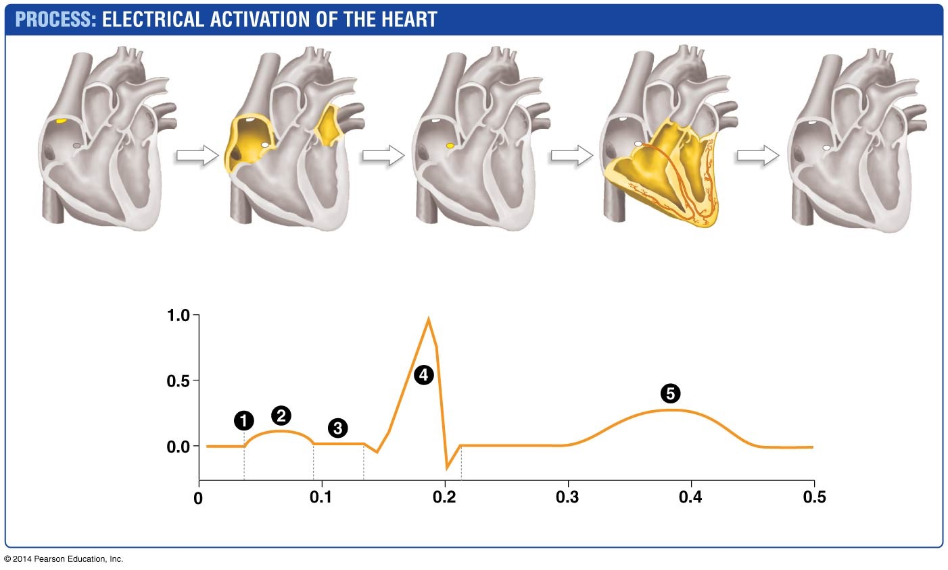
Figure 45.25
SA
node
AV
node
1. Signal originates
at SA node.
2. Signal spreads over
atria; atria contract.
3. Signal delays
at AV node.
4. Signal spreads down
conducting fibers to
bottom of ventricles;
ventricles contract.
5. Ventricles
relax.
Electrical activity
(millivolts)
Time (seconds)
Notes:
FIGURE 45.25 Sequential Electrical Activation Leads to Coordinated Contraction of the Heart.

Slide 113
The Cardiac Cycle Overview
BLAST Animation: The Cardiac Overview

Slide 114
Hypertension
Blood pressure is given with systolic pressure as the numerator and diastolic pressure as the denominator
People with blood pressures consistently higher than 140/90 mm Hg have high blood pressure, or hypertension
A serious health concern because it can lead to a variety of circulatory system defects
Abnormally high blood pressure puts mechanical stress on arteries; if the walls of an artery fail, the individual may experience heart attack, stroke, kidney failure, and burst or dilated blood vessels

Slide 115
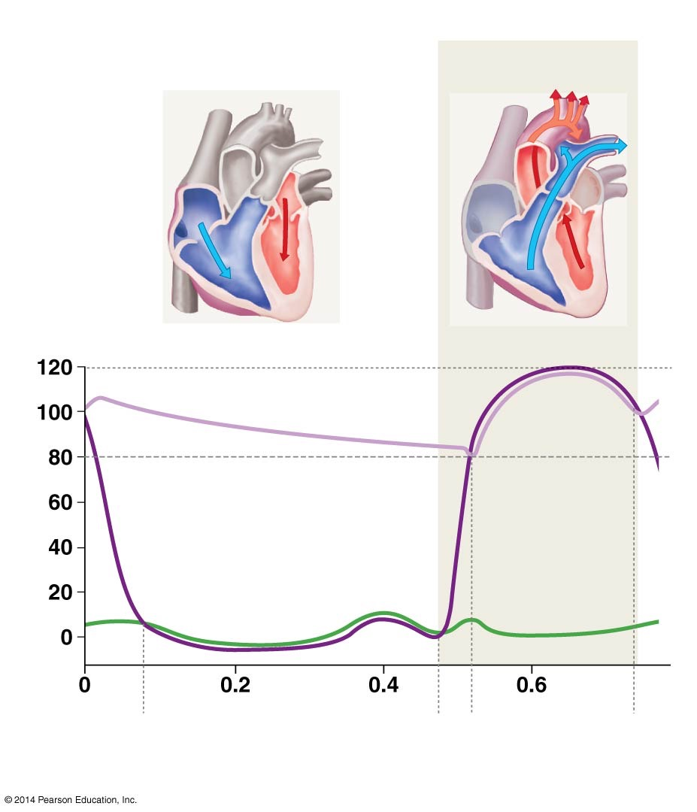
Figure 45.26
Cardiac cycle
Ventricular diastole
Ventricular systole
AV
valves
Aortic
valve
Systolic blood pressure
Diastolic blood pressure
Pressure (mm Hg)
Aortic pressure
Ventricular pressure
Atrial pressure
AV
valves
open
Time (seconds)
AV
valves
close
Aortic
valve
opens
Aortic
valve
closes
Notes:
FIGURE 45.26 Blood Pressure Changes during the Cardiac Cycle.

Slide 116
The Human Heart
Web Activity: The Human Heart

Slide 117
Electrical Activation of the Heart
Pacemaker cells that initiate contraction in the heart are located in a region of the right atrium called the sinoatrial (SA) node
The SA node and the heart muscle cells receive input from the nervous system and from chemical messengers in the blood
These inputs are important for regulating the heart rate

Slide 118
Electrical Activation of the Heart
The electrical impulse generated by the SA node is rapidly conducted throughout the right and left atria
The signal spreads quickly from cell to cell because cardiac muscle cells form physical and electrical connections
Heart muscle cells are connected by specialized structures called intercalated discs
Because these discs contain numerous gap junctions, electrical signals pass directly from one cell to the next
Gap junctions are connections through which cells communicate

Slide 119
Electrical Activation of the Heart
Once the electrical signal has swept over the atria, it is conducted to an area of the heart called the atrioventricular (AV) node, which passes it on to the ventricles
There is a delay in the passing of the signal from the AV node
This delay allows the ventricles to fill completely
The final event is the signal to relax the ventricles
The electrical activation of the heart can be measured through an electrocardiogram (EKG)

Slide 120
Electrical Activation of the Heart
Key events in the heart’s electrical activation include
The SA node originates a signal
The signal from the SA node is propagated over the atria, which contract simultaneously and fill the ventricles
The signal is conducted to the AV node, which relays the signal to the ventricles after they fill completely with blood
The electrical impulse is rapidly transmitted through both ventricles, causing them to contract as the atria relax
The final electrical event occurs as the ventricles relax and their cells recover

Slide 121
Figure 45.25
SA
node
AV
node
1. Signal originates
at SA node.
2. Signal spreads over
atria; atria contract.
3. Signal delays
at AV node.
4. Signal spreads down
conducting fibers to
bottom of ventricles;
ventricles contract.
5. Ventricles
relax.
Electrical activity
(millivolts)
Time (seconds)
Notes:
FIGURE 45.25 Sequential Electrical Activation Leads to Coordinated Contraction of the Heart.

Slide 122
Electrical Coordination of the Cardiac Cycle
BLAST Animation: Electrical Coordination of the Cardiac Cycle

Slide 123
Patterns in Blood Pressure and Blood Flow
Blood pressure is the force that blood exerts on the walls of arteries, capillaries, and veins
Blood pressure drops dramatically as blood moves through the capillaries, because the total cross-sectional area of blood vessels in the circulatory system increases greatly
The drop in blood pressure decreases the rate of blood flow to allow sufficient time for gases, nutrients, and wastes to diffuse between tissues and blood in the capillaries

Slide 124
Figure 45.26
Cardiac cycle
Ventricular diastole
Ventricular systole
AV
valves
Aortic
valve
Systolic blood pressure
Diastolic blood pressure
Pressure (mm Hg)
Aortic pressure
Ventricular pressure
Atrial pressure
AV
valves
open
Time (seconds)
AV
valves
close
Aortic
valve
opens
Aortic
valve
closes
Notes:
FIGURE 45.26 Blood Pressure Changes during the Cardiac Cycle.

Slide 125
Homeostatic Control of Blood Pressure
Blood movement is carefully regulated at an array of points throughout the circulatory system
The nervous system, along with certain chemical messengers in the circulation, can accurately control blood flow to various tissues by contracting or relaxing the arteriolar sphincters
Decreases in blood pressure elicit a powerful homeostatic response
Falling blood pressure is detected by baroreceptors in the walls of the heart and the major arteries

Slide 126
Homeostatic Control of Blood Pressure
When baroreceptors detect a major decrease in blood pressure, they trigger electrical signals that change the heart’s output and vessel diameter
The overall coordination of blood flow and pressure is under the control of the sympathetic nervous system
Cardiac output increases due to an increase in both heart rate and the amount of blood pushed out by the ventricles

Slide 127
Homeostatic Control of Blood Pressure
Arterioles serving the capillaries of noncritical tissues are constricted to divert blood to more critical organs
The veins are constricted, shifting blood volume toward the heart and arteries to maintain blood pressure and flow to vital organs

Slide 128
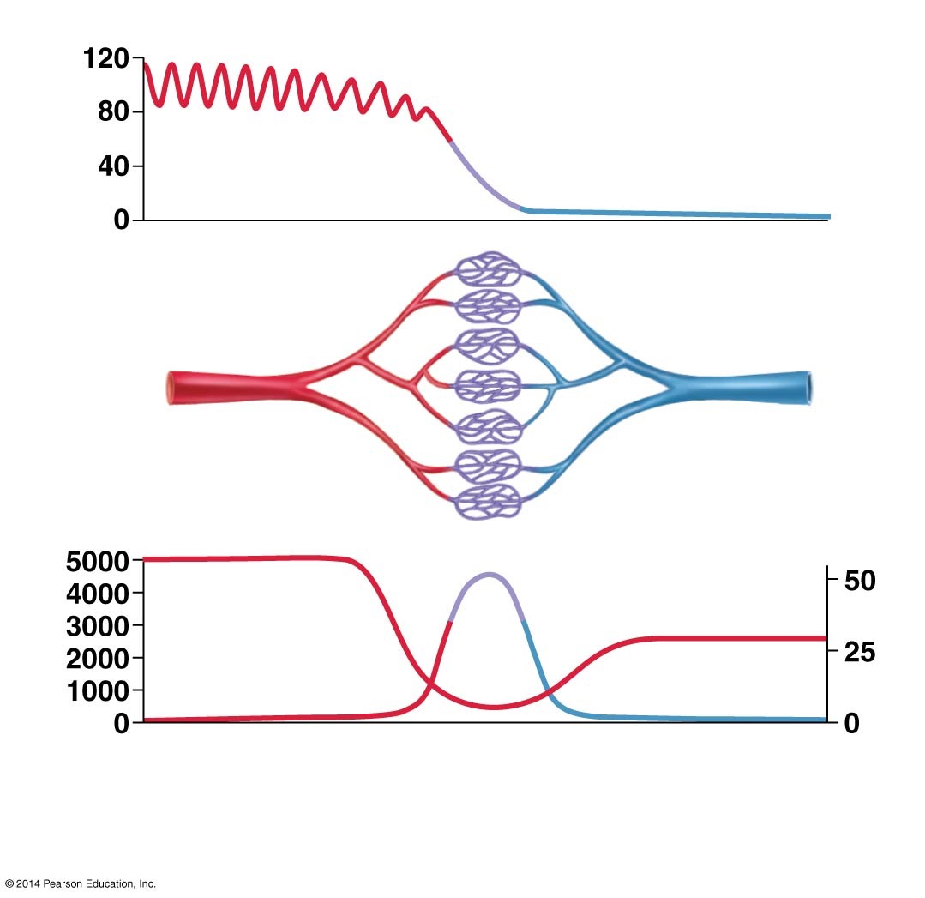

Figure 45.27
From heart
Capillaries
Return to heart
Pressure
(mm Hg)
Velocity
Velocity (cm/sec)
Total area
Arterioles
Capillaries
Venules
Small veins
Main veins
Main arteries
Small arteries
Notes:
FIGURE 45.27 Blood Pressure Drops Dramatically in the Circulatory System.

